Slide 1
Processor Design

Slide 2
Introduction
§4.1 Introduction
CPU performance factors
Instruction count
Determined by ISA and compiler
CPI and Cycle time
Determined by CPU hardware
We will examine two MIPS implementations
A simplified version
A more realistic pipelined version
Simple subset, shows most aspects
Memory reference: lw, sw
Arithmetic/logical: add, sub, and, or, slt
Control transfer: beq, j

Slide 3
Instruction Execution Steps
PC → instruction memory, fetch instruction
Register numbers → register file, read registers
Depending on instruction class
Use ALU to calculate
Arithmetic result
Memory address for load/store
Branch target address
Access data memory for load/store
PC ← target address or PC + 4

Slide 4
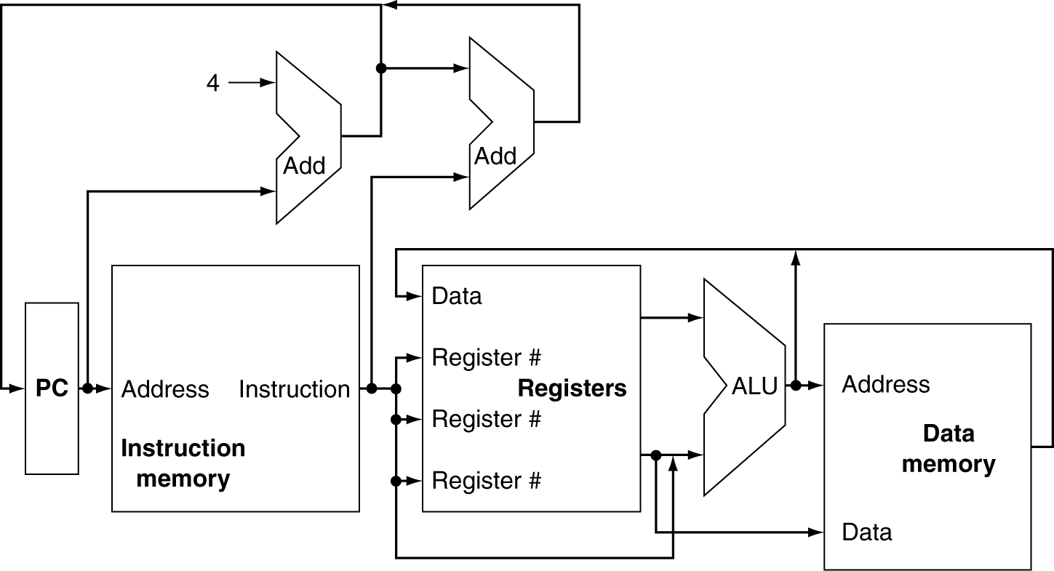
CPU Overview

Slide 5
Multiplexers
Can’t just join wires together
Use multiplexers

Slide 6
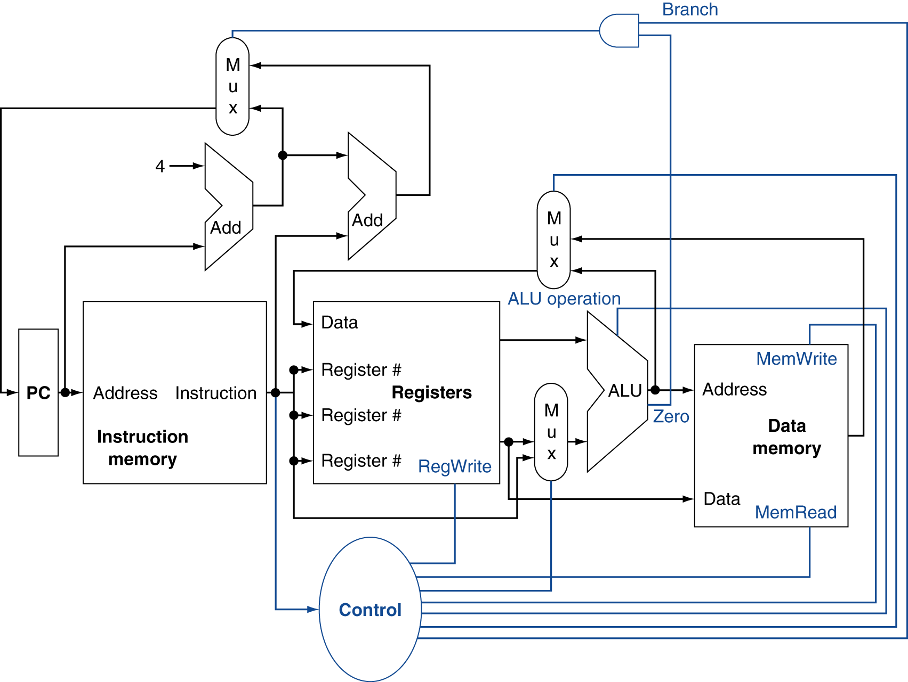
Control

Slide 7
Logic Design Basics
§4.2 Logic Design Conventions
Information encoded in binary
Low voltage = 0, High voltage = 1
One wire per bit
Multi-bit data encoded on multi-wire buses
Combinational element
Operate on data
Output is a function of input
State (sequential) elements
Store information

Slide 8
Combinational Elements
AND-gate
Y = A & B
Adder
Y = A + B
A
+
Y
B
A
Y
B
Arithmetic/Logic Unit
Y = F(A, B)
Multiplexer
Y = S ? I1 : I0
A
I0
M u x
Y
Y
ALU
I1
B
S
F
Notes:
Y=S?l1:;l2 means Y is l1 if S is true (or 1) else Y is l2

Slide 9
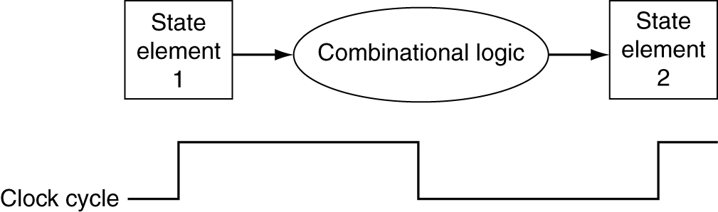
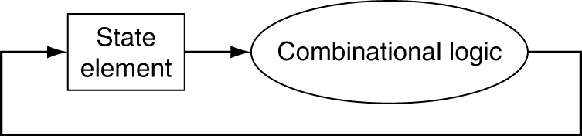
Clocking Methodology
Combinational logic transforms data during clock cycles
Between clock edges
Input from state elements, output to state element
Longest delay determines clock period
Notes:
Clocking methodology determines when signals can be read and when they can be written. Signal cannot be written at the same time that it is read.. MIPS uses an “edge triggered clocking”: Any value stored in a sequential logic element are updated only on a clock edge.
The right hand side diagram allows a state element to be read and written at the same clock cycle without causing a race.

Slide 10
Sequential Elements
Register: stores data in a circuit
Uses a clock signal to determine when to update the stored value
Edge-triggered: update when Clk changes from 0 to 1
Clk
D
Q
D
Clk
Q

Slide 11
Sequential Elements
Register with write control
Only updates on clock edge when write control input is 1
Used when stored value is required later
Clk
D
Q
Write
Write
D
Clk
Q

Slide 12
Building a Datapath
§4.3 Building a Datapath
Datapath
Elements that process data and addresses in the CPU
Registers, ALUs, mux’s, memories, …
We will build a MIPS datapath incrementally
Refining the overview design

Slide 13
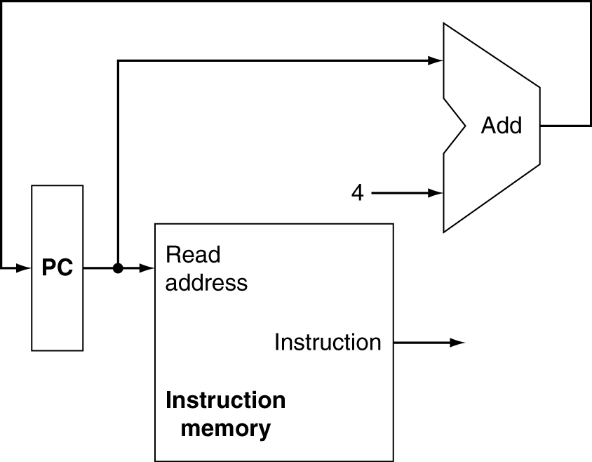
Instruction Fetch
Increment by 4 for next instruction
32-bit register

Slide 14
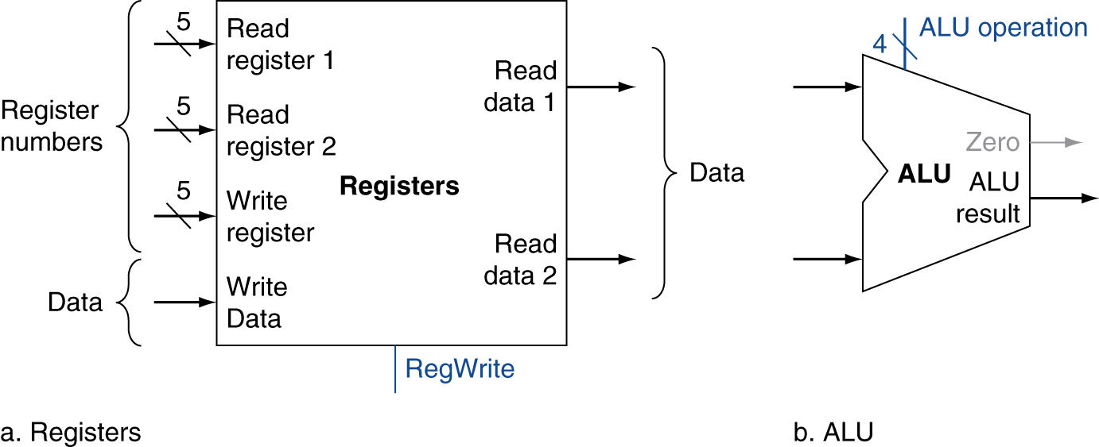
R-Format Instructions
Read two register operands
Perform arithmetic/logical operation
Write register result
Notes:
Example R-format instruction: add $t1, $t2, $t3 which adds the value of $t2 and $t3 into $t1

Slide 15
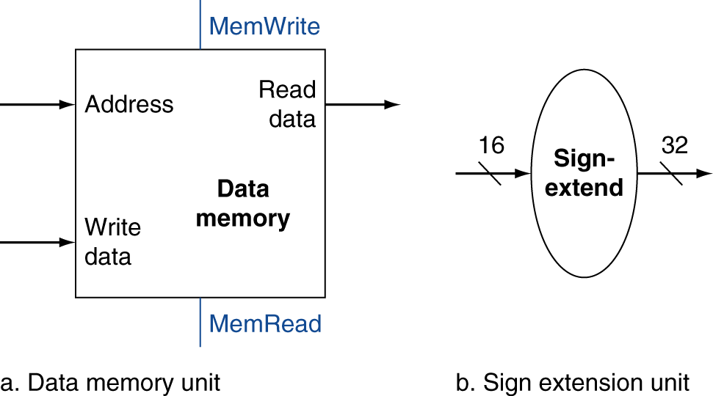
Load/Store Instructions
Read register operands
Calculate address using 16-bit offset
Use ALU, but sign-extend offset
Load: Read memory and update register
Store: Write register value to memory
Notes:
lw $t1, off_set($t2) or sw $t1, offset($t2) Memory address is computed by adding the offset to $t2, the base register. If lw, the value from memory will write into $t1. If sw, the value in $t1 will be written into memory.

Slide 16
Branch Instructions
Read register operands
Compare operands
Use ALU, subtract and check Zero output
Calculate target address
Sign-extend displacement
Shift left 2 places (word displacement)
Add to PC + 4
Already calculated by instruction fetch

Slide 17
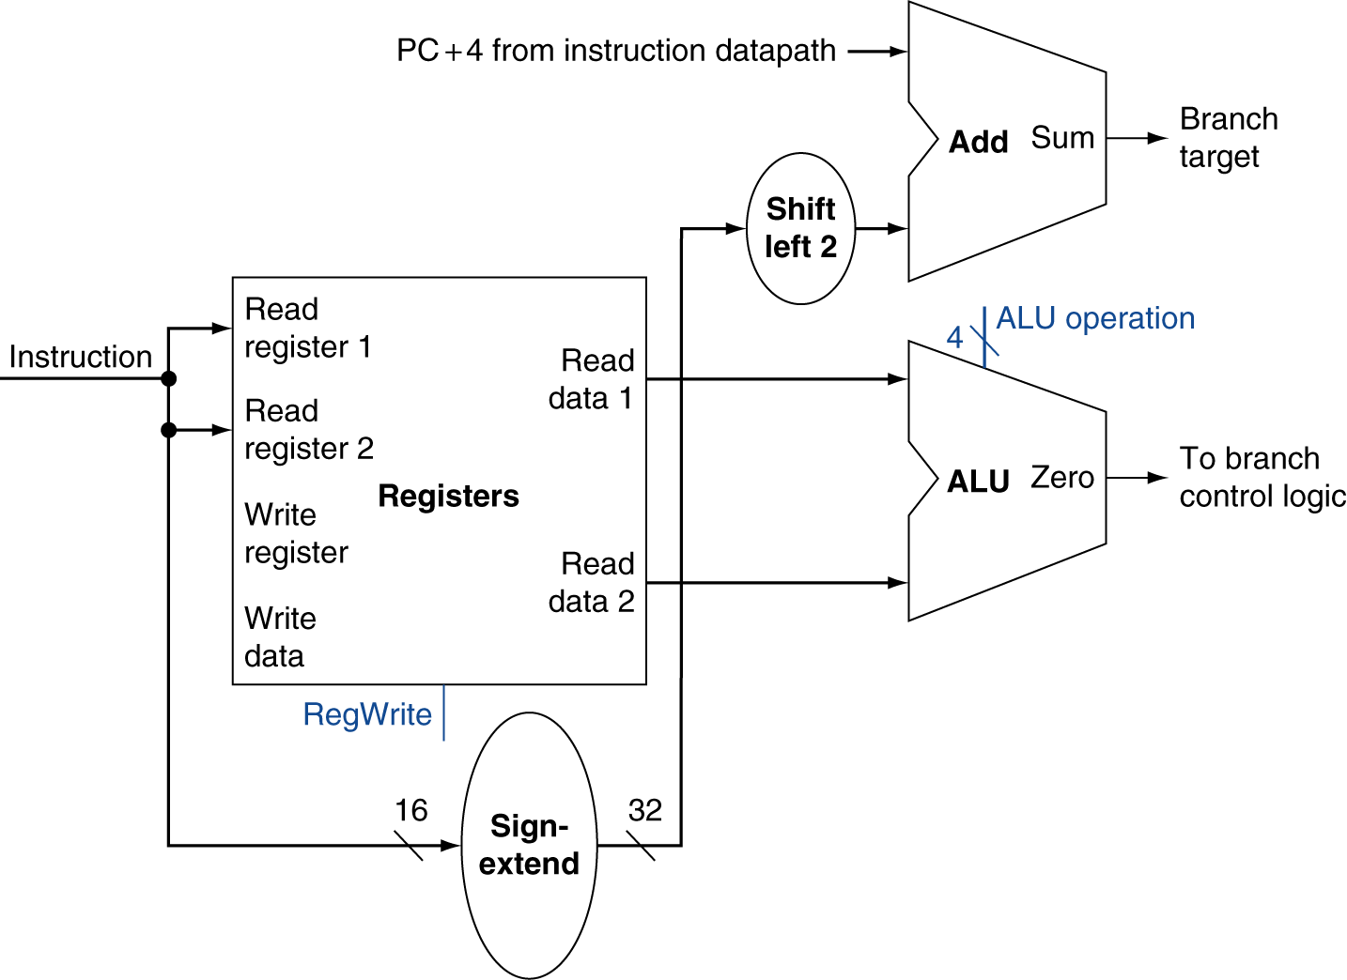
Branch Instructions
Just re-routes wires
Sign-bit wire replicated

Slide 18
Composing the Elements
First-cut data path does an instruction in one clock cycle
Each datapath element can only do one function at a time
Hence, we need separate instruction and data memories
Use multiplexers where alternate data sources are used for different instructions

Slide 19
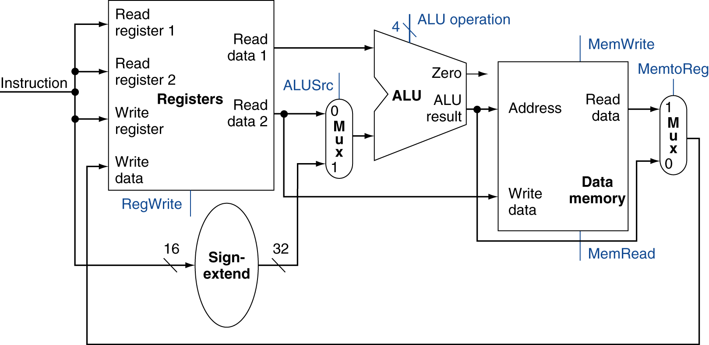
R-Type/Load/Store Datapath
Notes:
The left MUX allows to select whether the input is from a register (R type instruction) or from the sign-extended to add offset to the base register.
The right MUX selects either data from the ALU or from data memory (for the lw instruction).

Slide 20
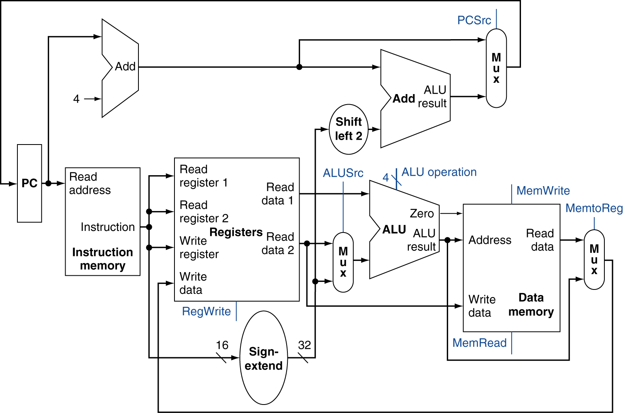
Full Datapath
Notes:
Composing ppt 13 (program counter increment), 19 (instruction execution), and 17 (branch instruction)
This is a one cycle datapath. It requires separate data and instruction memories because we cannot use a single ported memory for two different access during a cycle
In a load instruction, MemToReg control should be set to send data from the data memory to the register.

Slide 21
ALU Control
ALU used for
Load/Store: F = add
Branch: F = subtract
R-type: F depends on funct field
§4.4 A Simple Implementation Scheme
ALU control | Function
0000 | AND
0001 | OR
0010 | add
0110 | subtract
0111 | set-on-less-than
1100 | NOR
Notes:
Page 259
ALU control defined in Appendix B

Slide 22
ALU Control
Assume 2-bit ALUOp derived from opcode
Combinational logic derives ALU control
opcode | ALUOp | Operation | funct | ALU function | ALU control
lw | 00 | load word | XXXXXX | add | 0010
sw | 00 | store word | XXXXXX | add | 0010
beq | 01 | branch equal | XXXXXX | subtract | 0110
R-type | 10 | add | 100000 | add | 0010
 |  | subtract | 100010 | subtract | 0110
 |  | AND | 100100 | AND | 0000
 |  | OR | 100101 | OR | 0001
 |  | set-on-less-than | 101010 | set-on-less-than | 0111
Notes:
See page 85 in Chapter 2.
See the next ppt

Slide 23
The Main Control Unit
Control signals derived from instruction
R-type
0
rs
rt
rd
shamt
funct
31:26
25:21
20:16
15:11
10:6
5:0
Load/ Store
35 or 43
rs
rt
address
31:26
25:21
20:16
15:0
Branch
4
rs
rt
address
31:26
25:21
20:16
15:0
opcode
always read
read, except for load
write for R-type and load
sign-extend and add

Slide 24
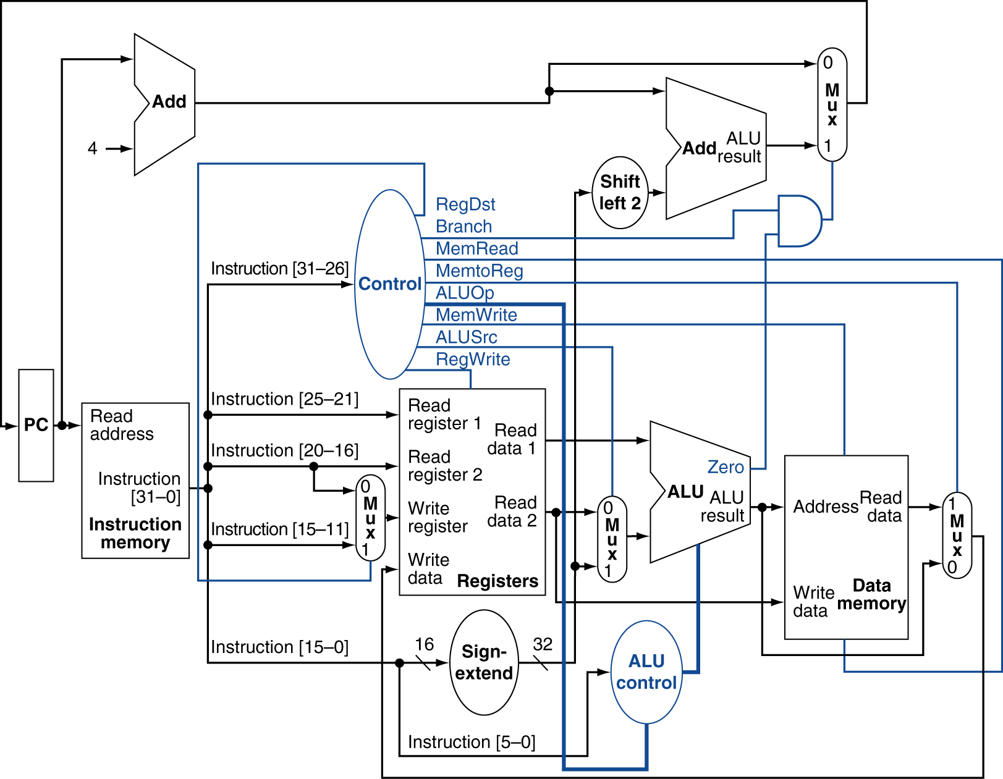
Datapath With Control

Slide 25
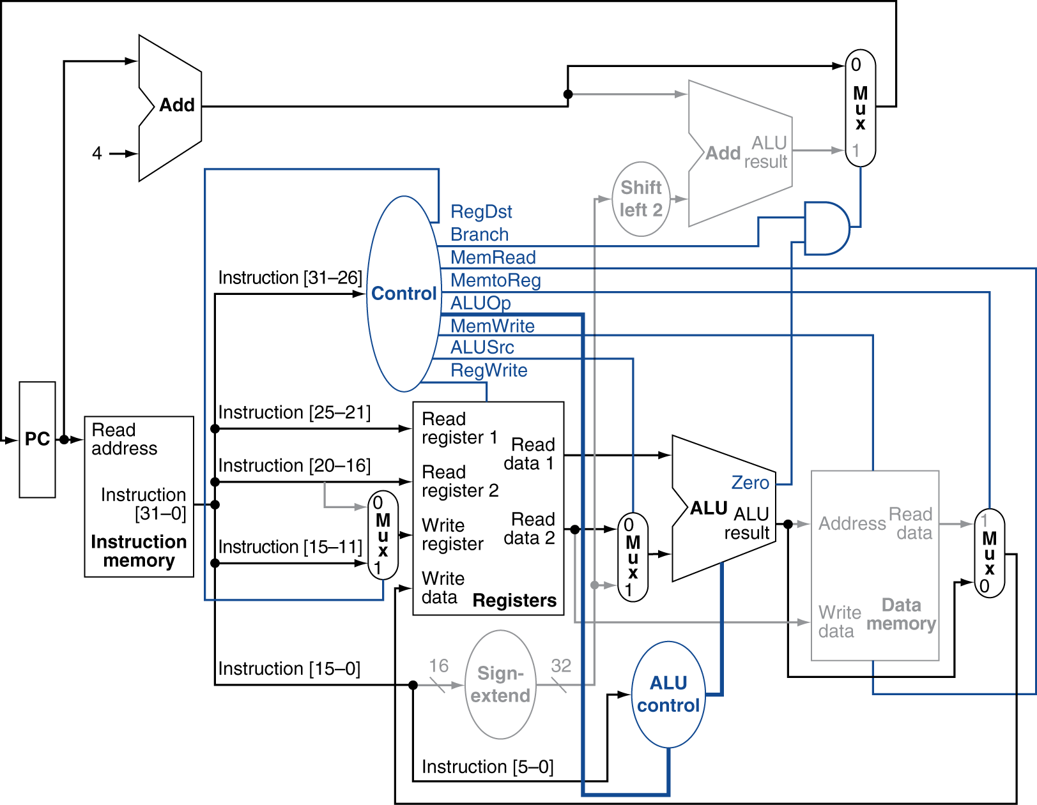
R-Type Instruction

Slide 26
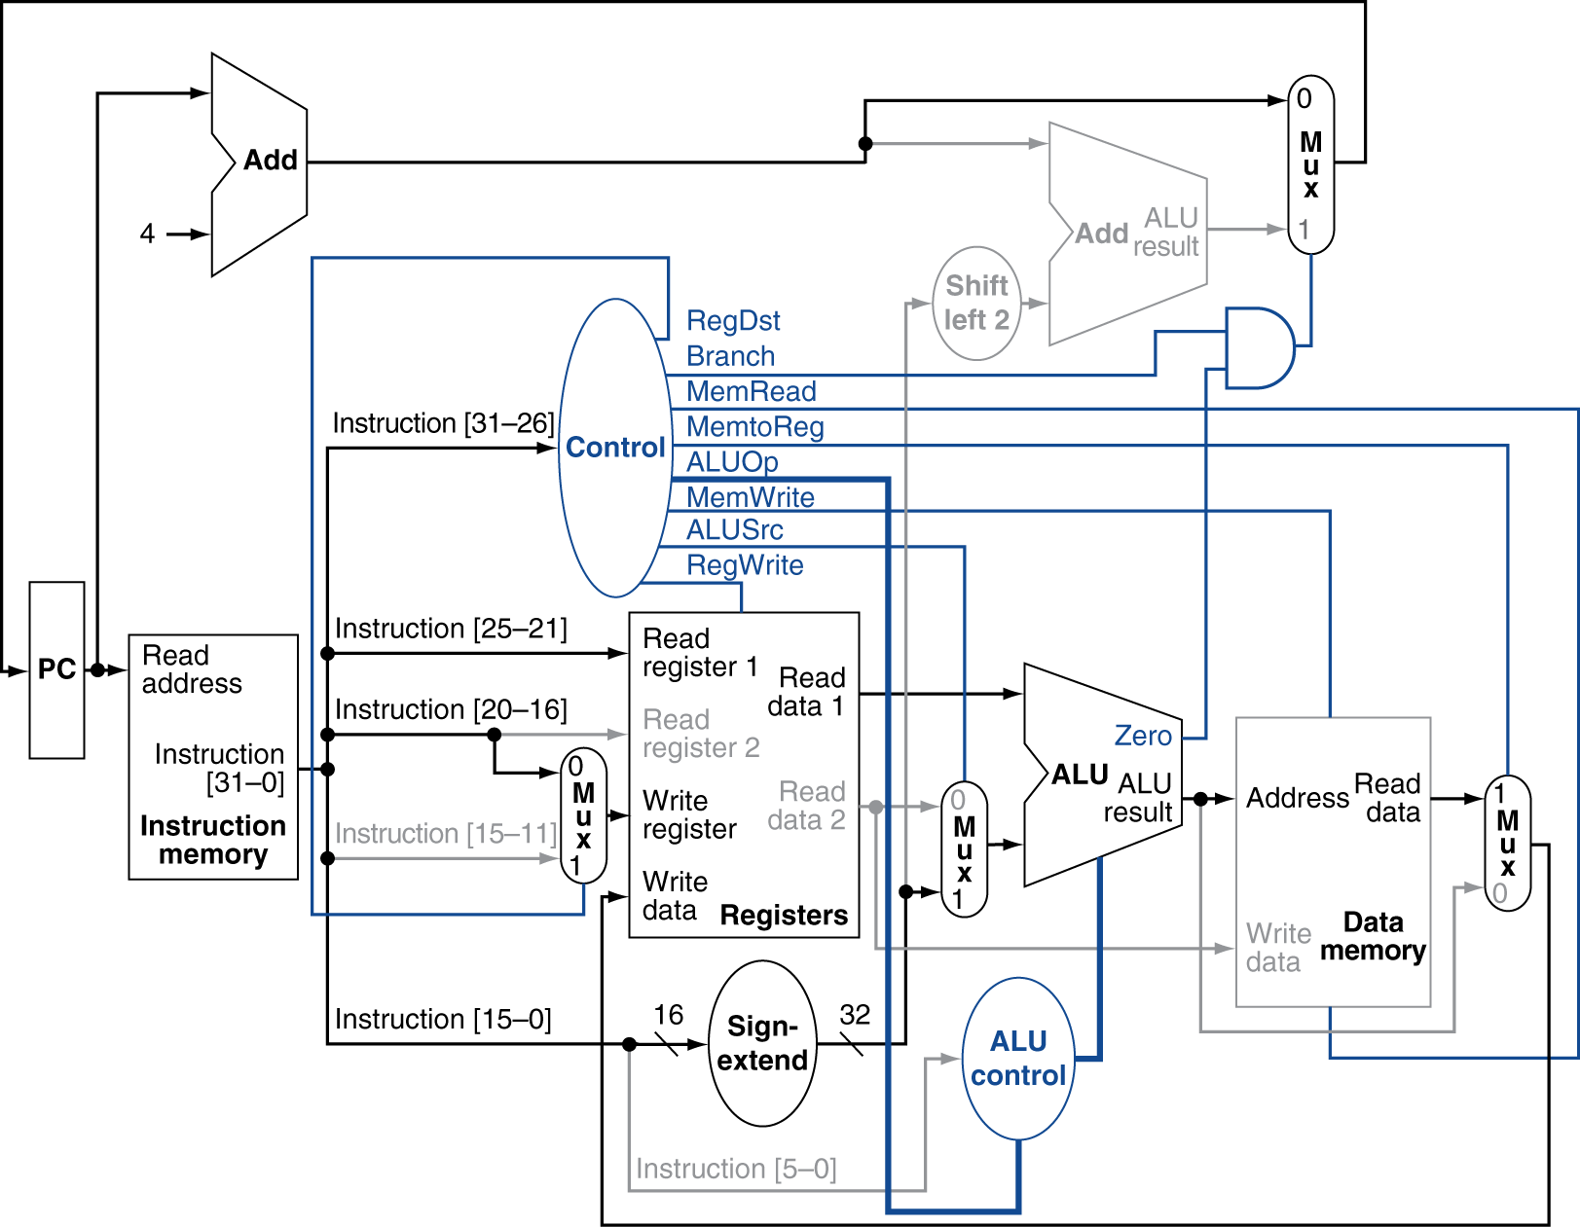
Load Instruction

Slide 27
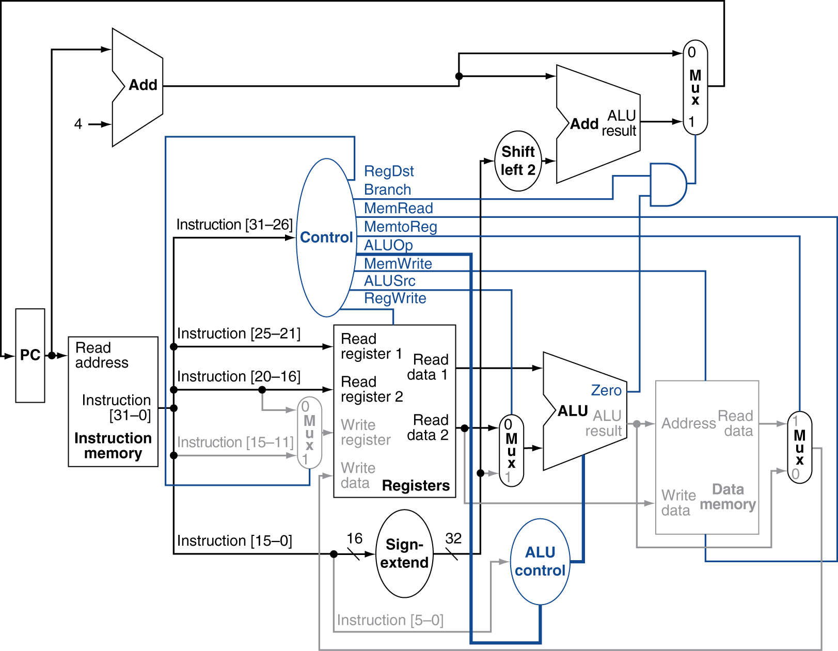
Branch-on-Equal Instruction

Slide 28
Implementing Jumps
Jump
2
address
31:26
25:0
Jump uses word address
Update PC with concatenation of
Top 4 bits of old PC
26-bit jump address
00
Need an extra control signal decoded from opcode

Slide 29
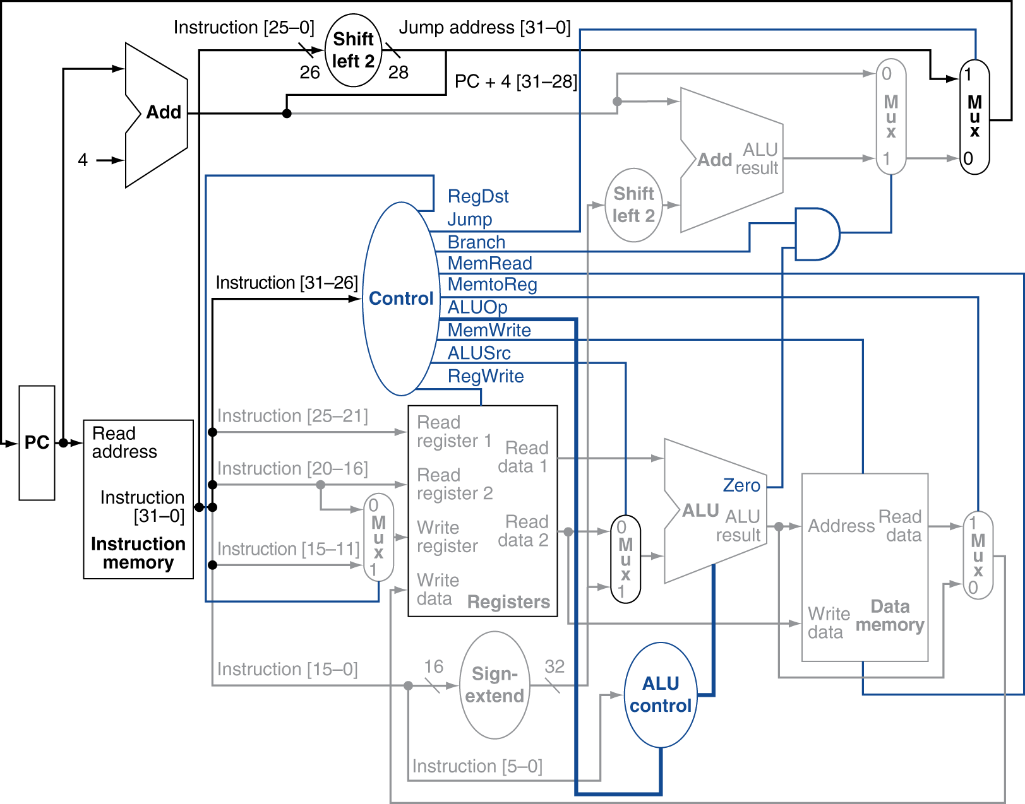
Datapath With Jumps Added

Slide 30
Performance Issues
Longest delay determines clock period
Critical path: load instruction
Instruction memory → register file → ALU → data memory → register file
Not feasible to vary period for different instructions
Violates design principle
Making the common case fast
We will improve performance by pipelining

